Slide 1
Adapted from 20 years’ research
Tor Dhal and Associates
Tor Dhal, Associate Professor
University of Minnesota
www.tordhal.com
Productivity leads to Profitability. Over a twenty year period of study of manager’s style of leading the finding is that a good leader produced 10 times the productivity and profitability versus a poor manager with poor leadership skills.

Slide 2
Pure/Raw Intelligence Which Gives Rise to the skills of : Emotional Intelligence Social Intelligence Moral/Ethical Intelligence Generational Intelligence Cultural Intelligence Gender Intelligence Collective Intelligence
The Kinds of Intelligence Required to be
A Global Leader

Slide 3
The Natural Laws Creating Leadership
Leaders have willing, voluntary loyal follower(s).
Leaders rely on influence beyond authority.
Leadership is a field of interaction, a relationship between leader and follower(s).
Not everyone will follow a leader’s initiative.
Leadership occurs as an event.
Leaders provide direction and operate outside the boundaries of organizationally defined procedures.
Leadership involves risks and uncertainty.
Consciousness, information processing creates leadership.
Leadership is a “self referral” process.

Slide 4
How can a leader fail? Self-deception Self-Sabotage Self-Importance (Ego) Self-Illusion (Self-absorption) Self-delusion Self-seduction .

Slide 5
Tools that move us from Insight to Action 30 Faciltation Tools in the Leadership Toolbox One Hundred Action Ideas to manage and lead

Slide 6
Countering
Self Sabotage

Slide 7
A. Right Action vs. B. Management Malpractice
A)Match tasks to people’s skills. B) Consistently assign tasks below or above a person’s capability.
A) Provide necessary resources such as funding, training, and tools. B) Withhold these necessary resources.

Slide 8
A. Right Action vs. B. Management Malpractice
A) Set realistic deadlines. B) Set artificial or unrealistic deadlines.
A) Minimize layers of management and bureaucracy. B) Support excessive layers of management and bureaucracy.

Slide 9
A. Right Action vs. B. Management Malpractice
A) Communicate openly and honestly. Share information in a timely manner. B) Communicate in a manipulative manner, such as withholding information or making people wait for necessary information.
A) Set directions, guidelines, and rules that are meaningful, consistent, and flexible. B) Change direction frequently and set restrictive, unnecessary, or inconsistent guidelines.

Slide 10
A. Right Action vs. B. Management Malpractice
A) Reward and recognize: provide constructive feedback on a regular basis. B) Withhold rewards and praise, or punish, criticize, and ridicule.
A) Cooperate, consult, and negotiate with associates. Entertain opinions. B) Issue orders and disallow choices and input.
.

Slide 11
Why Employees Don’t Do What They’re Supposed to Do? 1. They don’t know what they’re supposed to do. We pay them to do a lot of guessing. 2. They don’t know how to do what they’re supposed to do. Telling is not teaching. 3. They don’t know why they should do it. 4. There are obstacles beyond their control. 5. They think your way would not work. You have to be better at selling them not just telling them. 6. They think their way is better. Smart people sometimes think the wrong things.

Slide 12
7. They think something else is more important. They’re working on wrong priority items. 8. There’s no positive consequence for doing it. 9. They think they’re already doing it (no feedback). It’s after they’ve done it wrong – it’s too late to tell them. Use feedback to prevent failures. 10. They are rewarded for not doing it. Managers do it and don’t know it. 11. They are punished for doing what they are supposed to do. 12. They anticipate a negative consequence for doing it. The problem of fear. 13. There is no negative consequence to them for poor performance. Why don’t managers take corrective actions? 14. They are personally incapable of doing it (personal limits). 15. Personal problems. 16. Not enough time for them to do it.

Slide 13
17. Poor management. Research shows two general management causes for most of these reasons for non-performance. 1. The manager did something wrong to or for the employee. 2. The manager failed to do something right to or for the employee. In other words, employee non-performance occurred because of poor management.

Slide 14
The Q12 Process
Countering
Self Delusion or
Self Seduction

Slide 15
Employee Engagement Meta-analysis
(Most current 2016)
Business units that scored high on the 12 elements consistently
performed better than those that scored low. Highly engaged team
have increases in business outcomes.
10% higher success rate on customer metrics..
21% higher success rate in productivity.
20% higher success rate in profitability.
Results show that top quartile business units outperform bottom
Quartile units
Engagement Index Gallup Organization
1.8 Million Employees
49 Industries
82,000 Business/Work Units
Data gathered over 20-year period
73 Countries

Slide 16
ENGAGED EMPLOYEE: FOLLOWER
Loyal
Psychologically committed
More productive
More likely to stay at least one year
Less likely to have accidents or steal on the job
U.S.
30%
NOT ENGAGED: SUBORDINATE
Less productive
Not committed
More likely to miss workdays and more likely to leave
U.S.
54%
ACTIVELY DISENGAGED: INSUBORDINATE
Physically present -- psychologically absent
Unhappy with their work situation / insist on sharing that unhappiness with co-workers
U.S.
16%

Slide 17
ENGAGED EMPLOYEE: FOLLOWER
Loyal
Psychologically committed
More productive
More likely to stay at least one year
Less likely to have accidents or steal on the job
Canada
24%
NOT ENGAGED: SUBORDINATE
Less productive
Not committed
More likely to miss workdays and more likely to leave
Canada
60%
ACTIVELY DISENGAGED: INSUBORDINATE
Physically present -- psychologically absent
Unhappy with their work situation / insist on sharing that unhappiness with co-workers
Canada
16%

Slide 18
ENGAGED EMPLOYEE: FOLLOWER
Loyal
Psychologically committed
More productive
More likely to stay at least one year
Less likely to have accidents or steal on the job
France
9%
NOT ENGAGED: SUBORDINATE
Less productive
Not committed
More likely to miss workdays and more likely to leave
France
63%
ACTIVELY DISENGAGED: INSUBORDINATE
Physically present -- psychologically absent
Unhappy with their work situation / insist on sharing that unhappiness with co-workers
France
28%

Slide 19
ENGAGED EMPLOYEE: FOLLOWER
Loyal
Psychologically committed
More productive
More likely to stay at least one year
Less likely to have accidents or steal on the job
Singapore
6%
NOT ENGAGED: SUBORDINATE
Less productive
Not committed
More likely to miss workdays and more likely to leave
Singapore
76%
ACTIVELY DISENGAGED: INSUBORDINATE
Physically present -- psychologically absent
Unhappy with their work situation / insist on sharing that unhappiness with co-workers
Singapore
17%

Slide 20
Q 12 Process
Do I know what is expected of me at work?
Do I have the materials and equipment I need to do my work right?
At work, do I have the opportunity to do what I do best every day?
In the last seven days, have I received recognition or praise for good work?
Does my supervisor or someone else at work seem to care about me as a person?
Is there someone at work who encourages my development?

Slide 21
Q-12 Process
7. At work, do my opinions seem to count?
8. Does the mission/purpose of my company make me feel like my work is important?
9. Are my co-workers committed to doing quality work?
Does my supervisor create an environment where I can build good working relationships with my associates?
In the last six months, have I talked with someone about my progress?
At work, have I had opportunities to learn and grow?

Slide 22
Creating an Engaged Workforce
The Gallup Organization’s research shows that measuring the engagement
of a workplace can be simplified into twelve questions. These twelve
questions do not capture everything you may want to know about your
workplace, but they do capture the most information and the most
important information. They measure the core elements needed to
attract, focus and keep the most talented employees.

Slide 23
Talented Employees Need Effective World-Class Leaders/Managers
The talented employee may join an organization because of its charismatic leaders, its generous benefits, and its world-class training programs.
But how long that employee stays and how productive she is while she is there is determined by her relationship with her immediate supervisor.
Adapted from the book First Break All the Rules by Buckingham and Coffman

Slide 24
Countering Self-
Deception

Slide 25
Some internal questions to ask yourself
What role do I play in the problems that confront me?
Can I take responsibility for my part of the situation?
Can I see that I am part of the problem?
Can I see that the challenge is not the problem itself, but how I relate to the problem?
How do I treat myself, and others, as I am going through the problem?

Slide 26
Emotional Intelligence: the capacity to be aware of, control, and express one's emotions, and to handle interpersonal relationships judiciously and empathetically

Slide 27
Emotional Intelligence: Google: Test Your Emotional Intelligence Free EQ quiz

Slide 28
Passive
Passive
Aggressive
Aggressive
Assertive
E V I L
No Domination or emotional charge. Direct but non-confrontational.
Argumentative
Rebellious
Resistant
Compliant
Submissive
Wrong person
Wrong time
Fight and Flight
The Healthy Response
Flight
Fight
Notes:
Come in by columns

Slide 29
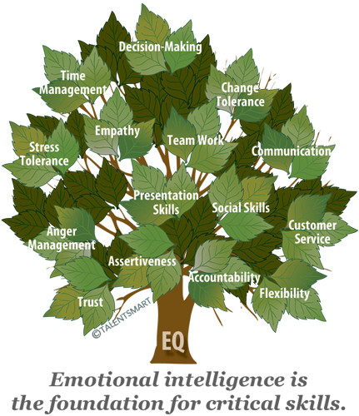

Slide 30
Social Intelligence: the capability to effectively navigate and negotiate complex social relationships and environments

Slide 31
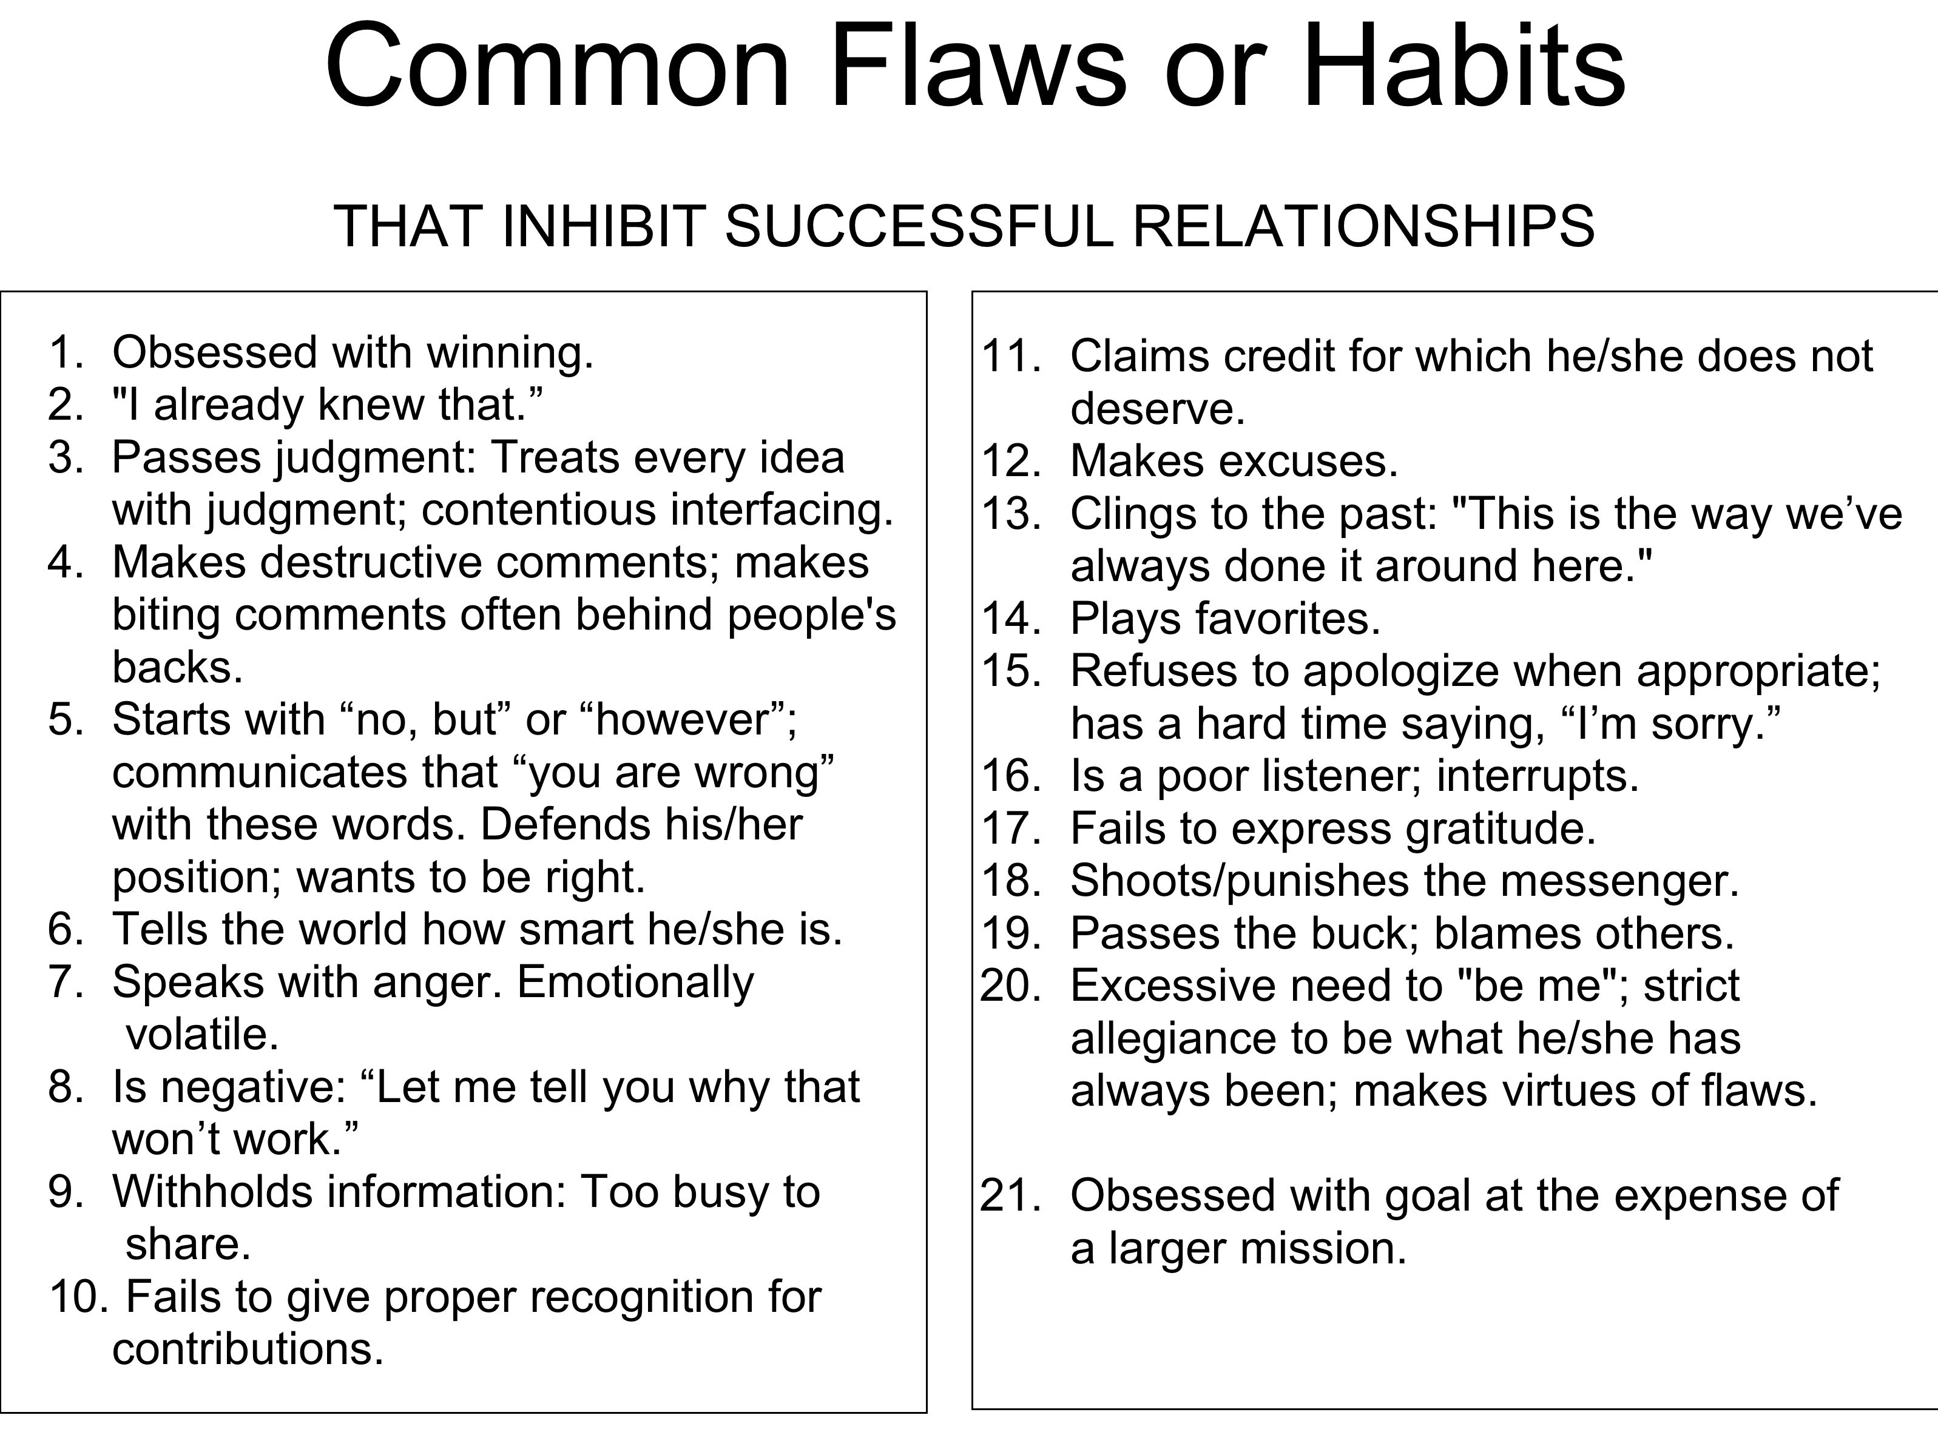

Slide 32
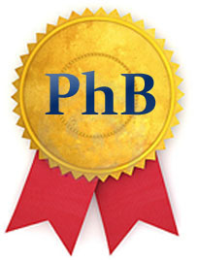
Obsessed with winning
I already knew that
Passes Judgement: argues and disagrees with Ideas that are not his/her own
Makes destructive comments often behind people’s backs
Starts with no, but or however communicates that you are wrong with these words. Wants to be right. Defends his/her position
Tells the world how smart he/she is
Speaks with anger. Emotionally volatile
Is negative: Let me tell you why that won’t work.

Slide 33
Moral Intelligence: is the capacity to understand right from wrong; it means to have strong ethical convictions and to act on them so that one behaves in the right and honorable way.

Slide 34
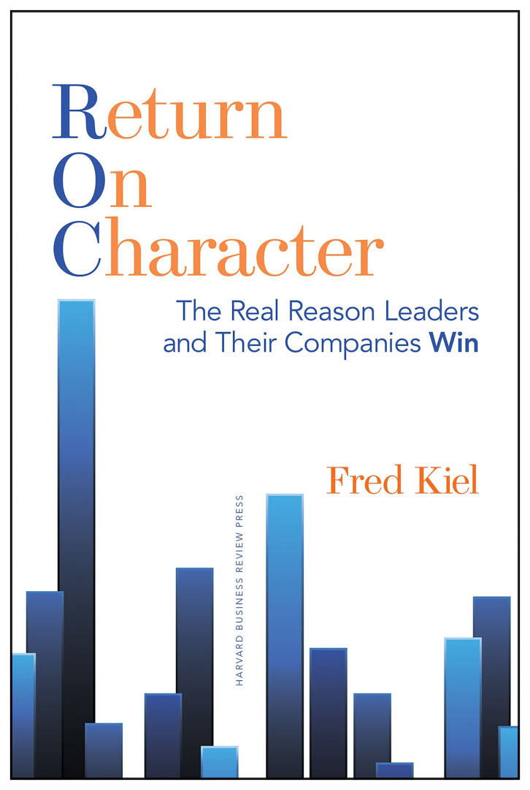
Return on Assets
9.35% Virtuoso
1.93% Self-focused

Slide 35
Return on Character
Integrity: right versus wrong, language employed, keeping promises, following through
Responsibility: self control, redress wrongs, admitting mistakes and failures
Forgiveness: Cooperation, mediation of conflict, empathy, letting go of the mistakes of others
Compassion: Helping people develop, caring

Slide 36
Return on Character
Openness
Conscientiousness
Extraversion
Agreeableness
No Aversion to Risk and Fear

Slide 37
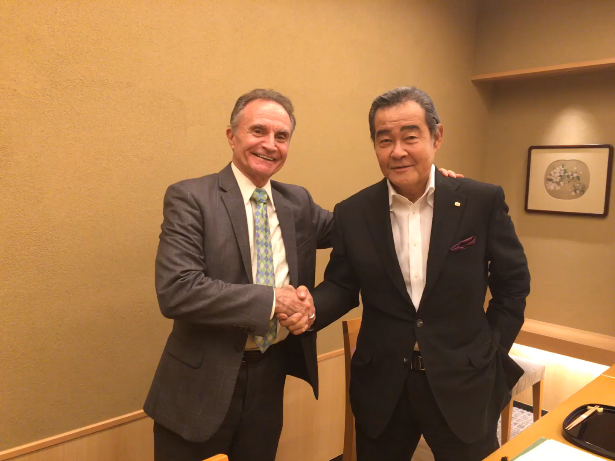

Slide 38
Gaining Edge/Competitive Strategy
Justice; Justice for employees, justice for the customer, and justice for our partners. Using the key concept of Bushido: the way of the warrior.(Samurai) He said that business is like waging war but with Bushido your weapons are loyalty, justice, personal honor, devotion to duty, and courage. This is part of Morinaga-san’s strategy.
His secret to success.

Slide 39
Generational Intelligence: A critical approach to age relations. Interpersonal relations based on age and the question of communication between people of different ages and generations.

Slide 40
Generational Intelligence: What is Millennial and Generation Z friendly leadership?

Slide 41
Gender Intelligence
We must go beyond arguments based on politics and fairness. Building an economic business case for gender diversity in the workplace is the reality. There are forty years of laws, quotas, diversity training, and legal expenses, in the U.S. aimed toward equalizing pay, opportunities, and working conditions between the sexes, the glass ceiling remains firmly intact and the gender imbalance remains.

Slide 42
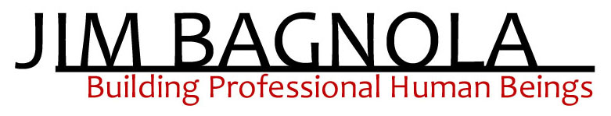
Women in Top Management
Research published by Catalyst in 2004 found that Fortune 500 companies with the highest percentage of women in top management or on the board significantly outperformed companies with the lowest percentage of women in those roles.
The Moment of Lift : How empowering women changes the world
Drawn from ‘The Future of Work’ by Richard Donkin

Slide 43
Women in Top Management
Companies With All-Male Boards Lead the Way In Asia, But Those With More Gender Diversity Among Their Directors Have Higher Return On Equity
Companies with greater female representation in the boardroom tend to be more profitable, but women still remain under-represented across Asia Pacific boards
Firms with at least 10 percent of female board members delivered a 14.9 percent return on equity compared to just 12.6 percent for those without.
At the bottom of the gender diversity rankings are South Korea and Japan with 2.6 percent and 3.3 percent female board members respectively, followed by Singapore at 7.7 percent.

Slide 44
“Women have many exceptional faculties bred in deep history:
A talent with words
A capacity to read non-verbal cues
Emotional sensitivity
Empathy; patience
An ability to do and think several things simultaneously
A penchant for long-term planning
A gift for networking and negotiating
A preference for cooperating and reaching consensus, and
Leading via egalitarian teams. Helen Fisher: The First Sex

Slide 45
As leaders, women tend to ~
• Link rather than rank workers.
Favor interactive-collaborative
leadership styles.
Sustain fruitful collaborations.
Be comfortable sharing information.
See redistribution of power as victory,
not surrender.
Readily accept ambiguity.
Honor intuition as well as pure “rationality.”
Be inherently flexible.
Appreciate cultural diversity. Judy Rosener: Competitive Secrets

Slide 46
Women practice improvisation skills with much greater ease than men.
Women are more self-determined and more trust-sensitive than men.
Women appreciate and depend upon their intuition more than men do.
Women, unlike men, focus naturally on empowerment, rather than on “power.”
Women understand and develop relationships with greater facility than men.
One difference in particular throws a spotlight on why the New Economy favors women. Namely: Women are far less “rank-conscious” than men. Tom Peters Re-Imagine

Slide 47
Most women listen more openly than men do.
Women listen between the lines, capturing body language together with actual words.
Women are more intuitive, possibly by nature.
They ask more questions to draw others out.
They are better at forming groups because they more easily subordinate their egos for the common good.
They are better at understanding customer needs.
They are naturally better communicators, perhaps because their communication skills mature earlier than men’s, almost always in their teens.
Women listen more before presenting.
They open up and yield more often, rather than forcing.
They facilitate others, rather than moving quickly to assert themselves.
Dennis Waitley: Empires of the Mind

Slide 48
They empower, rather than try to overpower.
McDonald believes women have a higher tolerance for ambiguity, because they’ve always been responsible for attending to the emotional needs of others, which are very fluid.
Women learn to read between the lines, and come up with creative solutions for accommodating people.
Women have been trained for today’s demands on management: listening, communicating, getting to the root of the problem.
Empires of the Mind: How to Lead and Succeed in a Knowledge-Based World Dennis Waitley

Slide 49
Cultural Intelligence: The capability to relate and work effectively across cultures. .

Slide 50
Core Cultural Values
What a culture values and cultural systems
Time Orientation
Low Context vs High Context
Individualism vs. Collectivism
Event vs. Clock : End when we feel to (relationship/spontaneity) vs. by the clock (punctuality/efficiency)
Low: Things are explicit and clear. Little left to assume. Direct High: People know how to think and behave. Understanding is assumed. Read between the lines. Indirect.
What’s best for the individual vs. Dedication and loyalty to the Group.

Slide 51
Core Cultural Values
What a culture values and cultural systems
3. Individualism vs. Collectivism
4. Low vs. High Power Distance
(high status vs. lower status)
5. Low vs. High Uncertainty Avoidance (Low: few rules , little
structure, few guidelines)
3. Individual. Stand out. vs. loyalty to organization and family. Blend in. Save face no shame.
4. Low: leaders and followers close to each other. Equal rights. High: More distance. Formal respect. Don’t question. High status individuals expected to know. Tell me exactly what I should do. Willing to accept views of superiors.
5. What extent are people at ease with the unknown. High: uncomfortable with uncertainty and risk. Low: welcome unpredictability.

Slide 52
Core Cultural Values
What a culture values and cultural systems
6. Principles first /Application first
7. Deciding: Consensual vs. Top
Down
8. Disagreeing: Confrontational vs..
Not confrontational
9. Trusting: Task based versus
relationship based
10. Scheduling: Linear
(one step at a time vs flexible.
sequential vs. fluid
5. Low vs. High Uncertainty Avoidance (Low: few rules , little
structure, few guidelines)
6. Principles First: Begin with a fact, statement or opinion and follow with concepts to back it up. Begin with summary statement. Application first: Develop the theory first and then present the fact or statement. Build the argument and then present the conclusion.7 Decisions decided in groups vs. Decisions made by individuals. 8.Direct versus indirect
9. Task: built on business activities, on reliability Relationship: trust built sharing meals, evening drinks, sharing personal time.

Slide 53
Eight Scales that Map the Culture
Communicating
Evaluating
Persuading
Leading
Deciding
Trusting
Disagreeing
Scheduling
Low Context vs. High Context
Direct Negative Feedback vs. Indirect Negative Feedback
Principles First vs. Application First
Egalitarian vs. Hierarchical
Consensual vs. Top down
Task Based vs. Relationship based
Confrontational vs. Avoid Confrontation
Linear vs. Flexible

Slide 54
Egalitarian
Best manager/boss is a facilitator among equals.
The organization tends to be flatter and communication often skips hierarchical lines.
It is all right to disagree with the boss even in public.
It is possible for associates to move on a project without getting the boss’ approval.
It is acceptable to email associates above you and below you.
The order of seating in an organization is not structured according to status or position.
Hierarchical
Status is important and the organization has many layers.
Communication often follows fixed lines.
Associates defer to the boss’ opinion especially in public.
Approval before moving on a project is usually required.
You may be seated and spoken to in order of your status and position.
The manager/boss is strong and leads from the front.

Slide 55
Egalitarian
Denmark
Israel
The Netherlands
Australia
Hierarchical
China
India
Korea
Japan
United States
Romania

Slide 56
ErinMeyer.com The Culture Map
Understand basics about communication and language and their relationship to culture.
Cultural Atlas.com : Very thorough
Kiss, Bow or Shake Hands
Study the language. Learning even a few phrases goes a long way when we are in another culture
Gain basic insights into where you are going. Visit www.davidlivermore.com for suggestions.
Be globally informed. BBC World News is one of the best. http://news.bbc.co.uk/2/hi/country_profiles/default.stm can be helpful. www.worldpress.org is another.

Slide 57
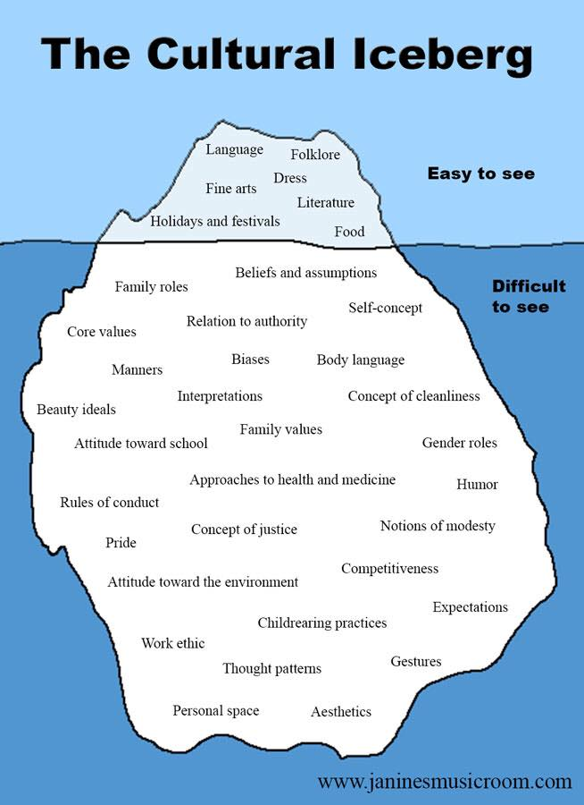
. .

Slide 58
Countering Self Illusion

Slide 59
Checking your ego at the door creates a climate that cultivates open dialogue rather than shutting it down. It unites rather than polarizes the organizational climate. Researchers: “Business Think.” Marcum, Smith and Khalsa.

Slide 60
How do you know when you haven’t checked your ego at the door?
Are you showcasing your brilliance?
Are you are constantly seeking the approval of others?
Are you are being defensive?
Are you spending more time talking than listening?
Are you taking it personally when your ideas are challenged?
Are you surprised when people don’t agree with you?.

Slide 61
How do you know when you haven’t checked your ego at the door?
Are you afraid to share your true thoughts and opinions for fear that others may not agree with or accept you?
Are you interrupting people because you think their point is irrelevant or inferior?
Are you referring people you report to as your “boss” and the people who report to you as “your employees,” rather than as your partners.
Are your associates feeling oppressed, humiliated, denergized or belittled by you after talking to you ?
Are your associates feeling worse about him or herself after a conversation with you?
Are you demeaning towards those who are less powerful rather than those who are more powerful?

Slide 62
Countering Self-Importance

Slide 63
You are neither above or below anyone.

Slide 64
Humility is not just a “nice to have” for leaders it is becoming an imperative for every leader to look at their humility and proactively increase it.

Slide 65
Studies have been done on arrogant and narcissistic managers by Dr. Stanley Silverman of the University of Akron and Don Hambrick of Penn State University

Slide 66
Dr. Silverman’s team from the University of Akron and a team from Michigan State University created WARS The Workplace Arrogance Scale a 360 degree questionnaire Research: finds humility is the antidote to arrogance and leads to overall increase in workplace productivity

Slide 67
Findings: Arrogant employees were less intelligent and skilled although pretended to be superior to others Arrogance prevailed in those who had low self-esteem They created tension, influenced the work badly, increased conflicts and misunderstandings

Slide 68
Findings: typical behaviors of arrogant and narcissistic managers ridiculing and trying to diminish coworkers’ ideas and achievements in front of everyone; imposing excess advice even in matters they are not competent about;

Slide 69
Findings: typical behaviors of arrogant and narcissistic managers weird non-verbal communication (e.g., staring at someone for a long time to make them feel awkward); behaving nicely with managers but being nasty to subordinates;

Slide 70
Findings: typical behaviors of arrogant and narcissistic managers making speeches at meetings and discussions a “one-man show”.

Slide 71
Dr. Silverman: Humility can be the antidote to arrogance. Humble individuals have a different personal orientation. They don’t act as if they are superior to others. They’re willing to see themselves accurately, and they want to know what their weaknesses are. Showing humility is not a sign of weakness — it’s a trait we want our leaders to have. Humility prevents excessive self-focus and allows a leader to develop better relationships with employees.”

Slide 72
Delicate balance between confidence/competence and humility

Slide 73
Humility is the great mediator. It will always be the shortest distance between you and another person.

Slide 74
Humility is the capstone quality of a leader It is a combination of personal humility and professional will

Slide 75
Humble leaders outperform the market by three times what their competitors did who were celebrity CEOs.

Slide 76
Collective Intelligence
Collective IQ is a measure of collective intelligence. Collective intelligence (CI) is shared or group intelligence that emerges from the collaboration, collective efforts, and competition of many individual. CI guides team facilitation.

Slide 77
Teams Succeed
Google study
When they are more collaborative (2015 Study), not just how they work but how they work together. Group norms override individual preferences.

Slide 78
Teams Succeed On How
Rather Than Who
Norms are the traditions, behavioral standards and unwritten rules that govern how we function when we gather.

Slide 79
Most Important Norms
First Norm
Researchers referred to as ‘‘equality in distribution of conversational turn-taking.’’ If only one person or a small group spoke all the time, the collective intelligence declined.’’ (Team IQ (collective intelligence) vs. Individual IQ).

Slide 80
Most Important Norms
Second Norm
The good teams all had high ‘‘average social sensitivity’’ — a fancy way of saying they were skilled at intuiting how others felt, based on their tone of voice, their expressions and other nonverbal cues. (Team IQ (collective intelligence) vs. Individual IQ).

Slide 81
Most Important Norms
Psychological Safety
Don’t discourage equal speaking. There would be few exchanges of the kind of personal information that lets teammates pick up on what people are feeling or leaving unsaid. There’s a good chance the members will continue to act like individuals once they come together.
(Team IQ (collective intelligence) vs. Individual IQ).

Slide 82
Psychological Safety
Teams succeed because:
Members can trust each other.
Honest discussion can occur without fear of retribution.
Members have roughly equal voices.
Teammates show that they are sensitive to one another’s emotions and needs.

Slide 83
Psychological Safety
Psychological Safety begins with the team leader/project Manager.
Reasons for choosing behaviors that undermine psychological Safety:
Seems more efficient to cut off debate and make a quick decision.
To listen to whoever knows most and ask others to hold their tongue.
Google People Analytics Group Project Oxygen

Slide 84
Most Important Norms
Psychological Safety
Within psychology researchers refer to traits like ‘‘conversational turn-taking’’ and ‘‘average social sensitivity’’ as aspects of what’s known as psychological safety — a group culture that the Harvard Business School professor Amy Edmondson defines as a ‘‘shared belief held by members of a team that the team is safe for interpersonal risk-taking.”
Psychological safety is ‘‘a sense of confidence that the team will not embarrass, reject or punish someone for speaking up,’’ Edmondson wrote in a study published in 1999. ‘‘It describes a team climate characterized by interpersonal trust and mutual respect in which people are comfortable being themselves.’’

Slide 85
Most Important Norms
Psychological Safety
Team lead/facilitator: Direct and straightforward, which creates a safe space for you to take risks vs. team leader has poor emotional control.
Enhance Communication and empathy — the building blocks of forging real connections.
Psychological safety and emotional conversations are related. The behaviors that create psychological safety.
We must be able to talk about what is messy or sad, to have hard conversations with colleagues.

Slide 86
Most Important Norms
Psychological Safety
Do encourage equal speaking. People may speak over one another, go on tangents and socialize instead of remaining focused on the agenda. The team may seem inefficient to a casual observer but all the team members speak as much as they need to. They are sensitive to one another’s moods and share personal stories and emotions.
(Team IQ (collective intelligence) vs. Individual IQ).

Slide 87
Psychological Safety
Psychological Safety begins with the team leader/project Manager.
Are you sharing control by genuinely listening, by repeating what someone said in your own words?
Are you keeping track who has spoken and who has not?
Are you responding to their comments?
Are you showing you care by reacting when someone seems upset or flustered instead of acting as if nothing is wrong?
Google People Analytics Group Project Aristotle
Google People Analytics Group Project Oxygen

Slide 88
Psychological Safety
Psychological Safety begins with the team leader/project Manager.
Are you encouraging equality in speaking or rewarding the loudest people?
Are you modeling listening?
Are you demonstrating a sensitivity to what people think and feel?
Are you letting decisive leadership be an excuse for not paying as close attention as you should?
Google People Analytics Group Project Aristotle
Google People Analytics Group Project Oxygen

Slide 89
What is required of Managers/Leaders in today’s Workplace?

Slide 90
Teacher
Advisor
Listener
Coach
Loves to help others succeed
Appreciator while focusing on results
Treats people equally by treating them differently
Open to difference
Builds leaders
Facilitates Constructive Conflict
Respectful, Caring, Demanding, holds people accountable to high standards
Energetic Energizer

Slide 91
Raw
Intelligence
Capacity
Building

Slide 92
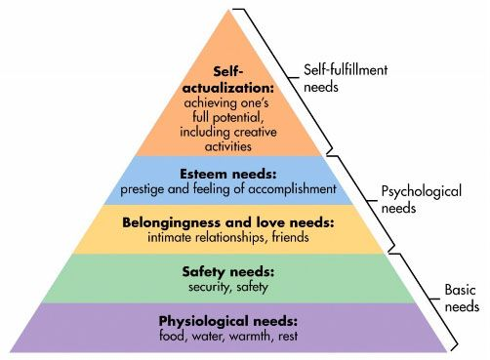
Maslow’s Hierarchy of Needs

Slide 93
Utilizing full potential is called Self-Actualization or Enlightenment. “Enlightenment can be described as the ultimate development of what we ordinarily consider to be the most valuable qualities of human life. This state is open to everyone starting from any level of consciousness.” (Maharishi,Wallace,Domash1971)

Slide 94
Increased Self-Actualization Through Transcendental Meditation
Increased self-actualization through Transcendental Meditation in contrast to other procedures as demonstrated by meta-analysis.
Statistical review of 42 independent research results: TM program was found to be four times as effective as other meditation and relaxation procedures in increasing self-actualization.

Slide 95
Personal Orientation Inventory E.L. Shostrom
Ability to live in the present.
Increased inner-directedness.
Independence and self-supportiveness.
Holding values of self-actualizing people.
Increased flexibility.
Increased spontaneity.
Increased self-regard.
Increased self-acceptance.
See man as essentially good.
Increased synergy.
Increased acceptance of feelings.
Increased capacity for warm interpersonal relationships.

Slide 96
Increased Self Actualization
Meta-analysis of 42 studies
TM
Other
Relaxation
Other
Meditations
0
0.5
1
Effect Size (Standard Deviations)
Alexander CN, Rainforth M, Gelderloos P:Journal of Social Behavior & Personality, 6:189-247,1991

Slide 97
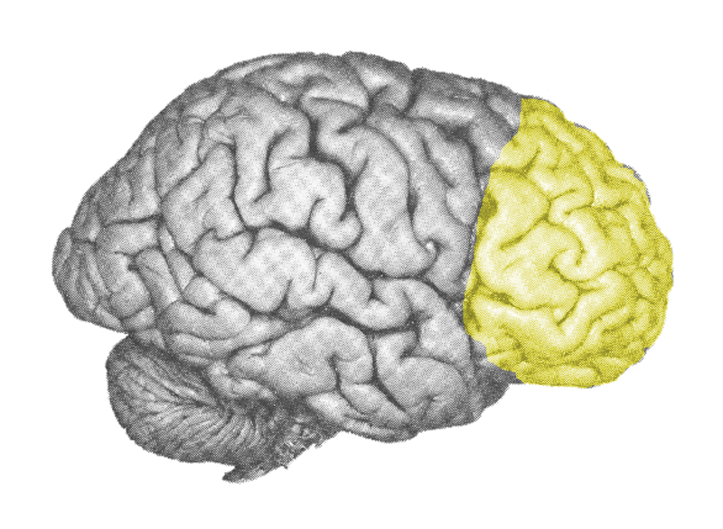
Concept
Learning
Moral
Reasoning
Emotional
Stability
Creativity
Decreased
Neuroticism
Inner
Orientation
CEO
Brainwave
Coherence
Intelligence
Self-
Development
Decreased
Anxiety
Computational
Efficiency
Learning
Ability
Neuromuscular
Flexibility
Self-
Awareness

Slide 98
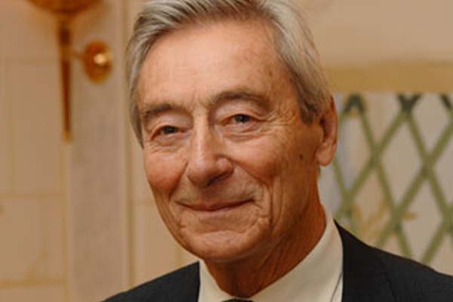
Former CEO Royal Dutch Shell
“The ability to learn faster than your competitors may be the only sustainable competitive advantage.”
― Arie de Geus ―

Slide 100
“…in looking for people to hire, you look for three qualities: integrity, intelligence, and energy. And if you don’t have the first, the other two will kill you.”
- Warren Buffett

Slide 101
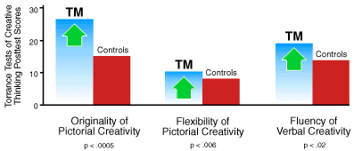
Increased Creativity
This study used the Torrance Tests of Creative Thinking to measure figural and verbal creativity in a control group and in a group that subsequently learned the Transcendental Meditation technique. On the posttest 5 months later, the Transcendental Meditation group scored significantly higher on figural originality and flexibility and on verbal fluency.

Slide 102
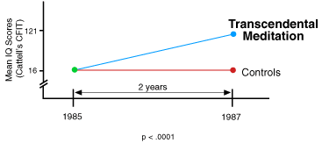
Development of Intelligence
Students at Maharishi International University in Fairfield, Iowa, who regularly practiced Transcendental Meditation, increased significantly in intelligence over a 2-year period, compared to control subjects from another Iowa university. This finding corroborates the results of two other studies showing increased IQ in Maharishi International University students.

Slide 103
Effectiveness in Reducing Trait Anxiety Meta-Analysis 146 Studies
TM
Placebo
Other Relaxation
Relaxation Response
Other Meditation
PMR
EMG-Biofeedback
Mantra Meditation
Concentration
0
.05
1
Journal of Clinical Psychology. 1989; 45:957-974
Notes:
103

Slide 104
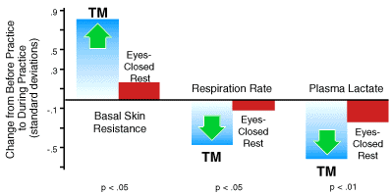
Physiological Indicators of Deep Rest
A meta-analysis, the preferred scientific procedure for drawing definitive conclusions from large bodies of research, found Transcendental Meditation produced a significant increase in basal skin resistance compared to eyes-closed rest, indicating profound relaxation. Deep rest and relaxation were also indicated by greater decreases in respiration rates and plasma lactate levels compared to ordinary rest. These physiological changes occur spontaneously as the mind effortlessly settles to the state of restful alertness, pure consciousness. Physiological differences between Transcendental Meditation and rest, American Psychologist 42:879-881, 1987.

Slide 105
Correlation of Brain Integration With:
* p < .05, ** p < .01 | Mean | Std | R (28)
Moral Reasoning | 3.46 | 0.41 | 0.66**
Emotional Stability | 3.86 | 0.85 | 0.52**
Openness to exp | 4.42 | 0.47 | 0.46*
State Anxiety | 27.75 | 11.92 | -0.46*
Trait Anxiety | 31.29 | 12.23 | -0.47*
Travis et al 2004, Consciousness and Cognition, 13/2, 401-420.

Slide 106
Elements of Consciousness
Energy
Creativity
Intelligence
Capacity to experience Happiness

Slide 107
Development of Consciousness
Self Actualization (full potential)
Transcending Pure Consciousness
Meditation (Raw Intelligence)
Waking State of Consciousness
Dream State
Deep Sleep
Unconscious

